Slide 1


Next JS

Slide 2

What is Next.js?
React Framework that allows us to build web applications using JavaScript and React more quickly
Better to use to create static and server-rendered applications
Benefits of server-rendered apps:
Faster initial page rendering
Better search engine optimisation
Notes:
A single-page app is created when all the resources needed to make the page run (like the HTML, CSS and JavaScript) are loaded at once. When the user interacts with the page there is no interaction with the server.
With a server-rendered application, JavaScript is executed on the server and the resulting HTML that is rendered is then sent to the browser.
Some of the benefits of server-rendered applications include:
1. The fact that JavaScript is executed on the server rather than on the browser can lead to faster initial page rendering. Slower clients may not be able to process JavaScript as quickly as servers. Prefetching initial data and building pages on the server also reduces the number of round trips required to view your site.
2. Server-rendered applications lead to better search engine optimization (SEO). A server-rendered application returns HTML instead of JavaScript. This means that pages returned with a server-rendered application are more easily indexable by search engines and previewable on social media platforms.

Slide 3
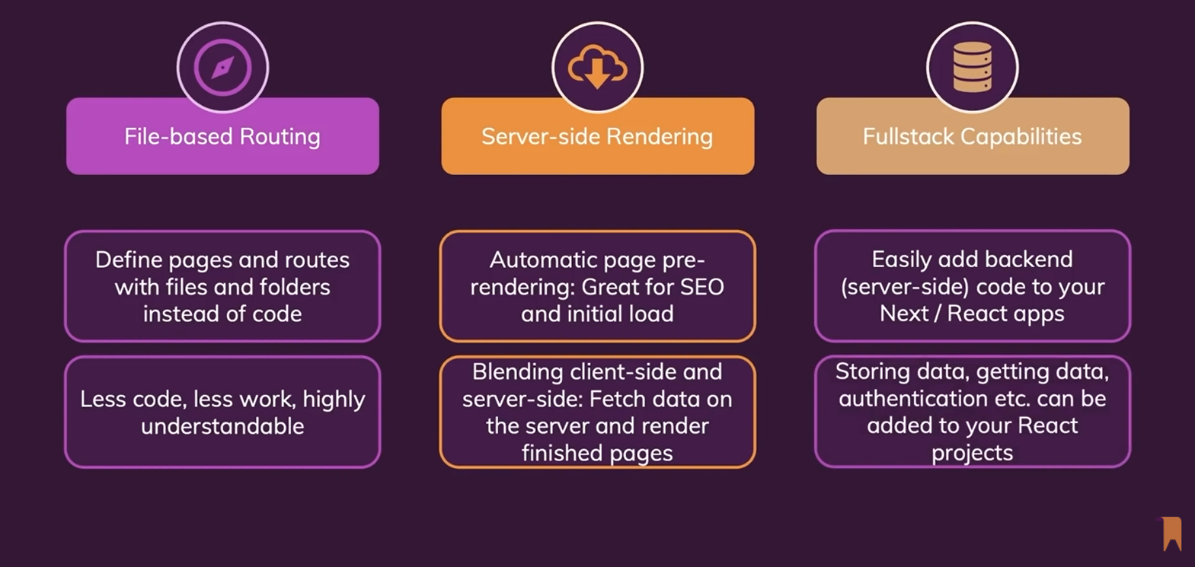
Next js Key features and benefits

Slide 4
Create an App with Next.js
Open your command line interface and create a project with a meaningful name.
E.g. npx create-next-app my-first-next-app
Navigate to the directory you have just created and open it by your code editor . E.g. cd my-first-next-app
Run the development server by typing npm run dev

Slide 5
Adding Links to Pages
To support client-side navigation we use Next.js’ Link API
import Link from ‘next/Link export default () => ( <div> <Link href=”/index”> <a>Home<a/> </Link> <p>This is the About page</p> </div> )

Slide 6
Adding Images and Other Static Resources
In folder called “static” in your project root directory
From your code, you can then reference those files with /static/ URLs
export default () => <img src="/static/my-image.png" alt="my image" />

Slide 7
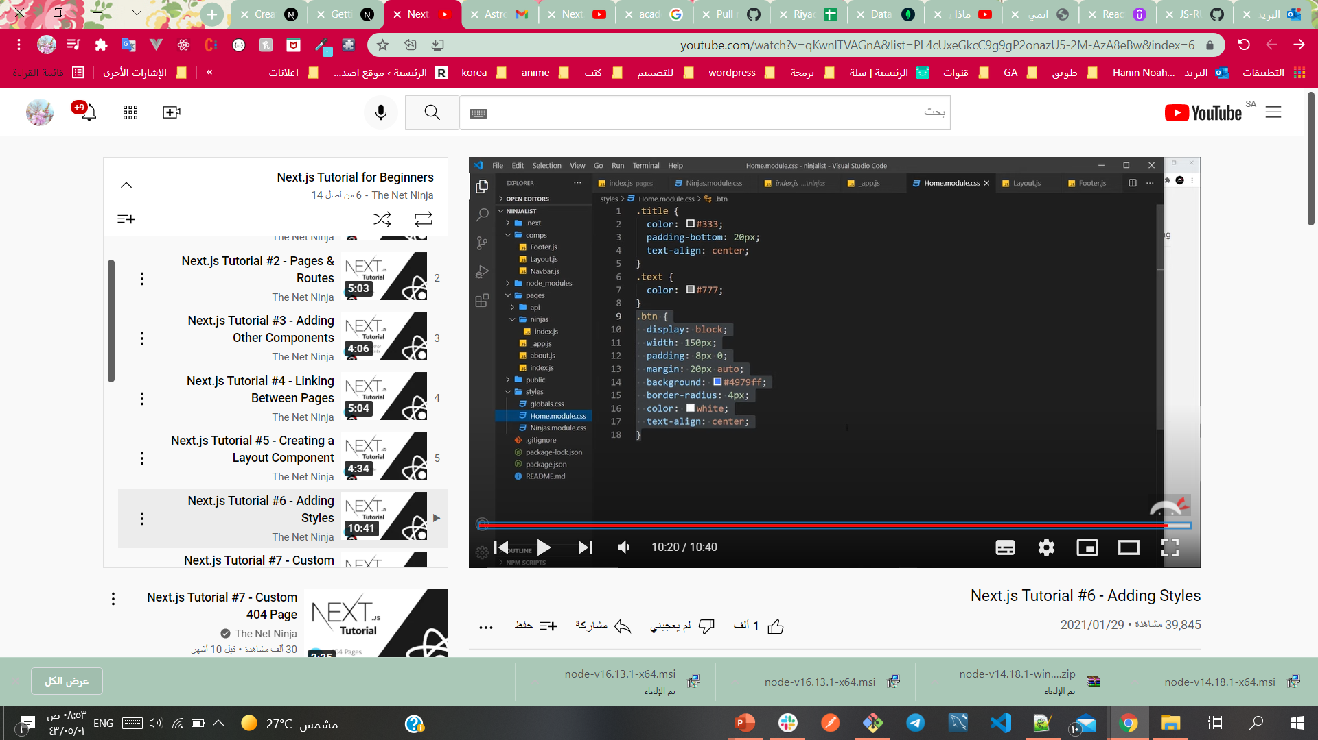
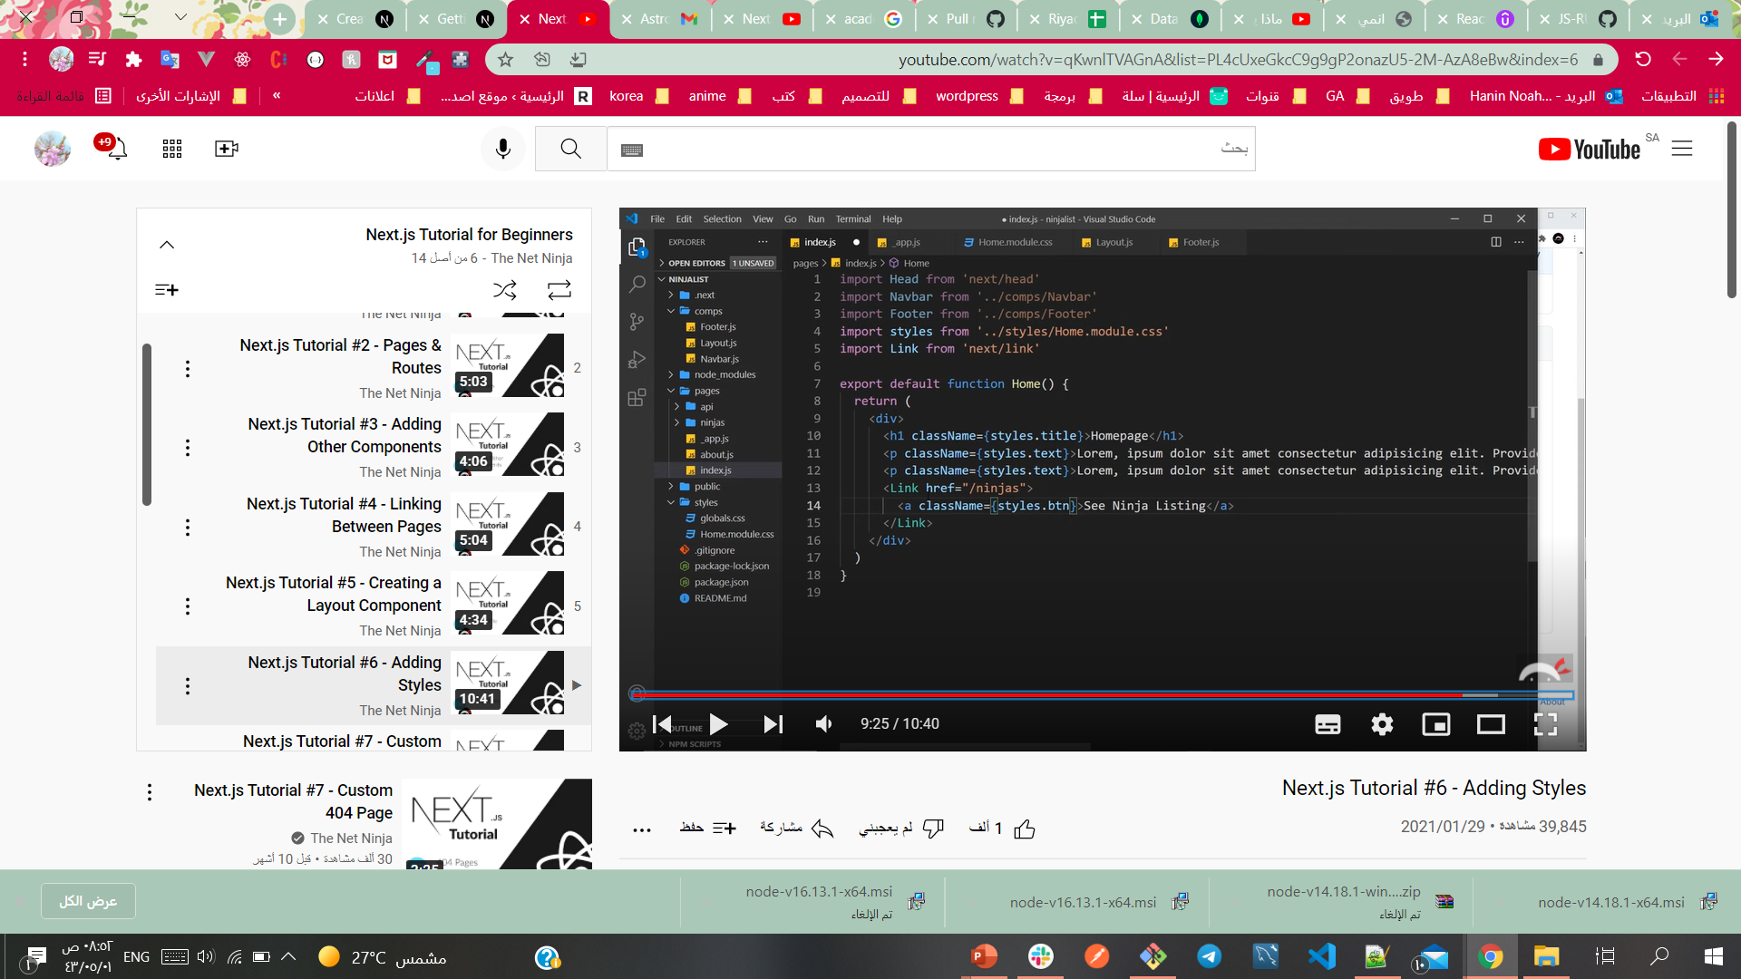
Styling Next.js Apps
You can customize for each file or in globals.css

Slide 8
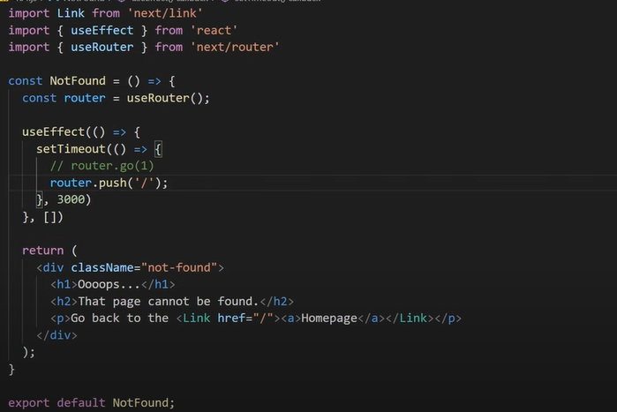
404 page with redirecting the user

Slide 9
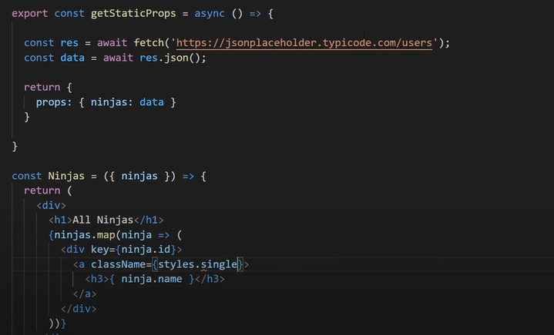
Fetching Data (getStaticProps)
https://nextjs.org/docs/basic-features/data-fetching
If you export an async function called getStaticProps from a page, Next.js will pre-render this page at build time using the props returned by getStaticProps.

Slide 10
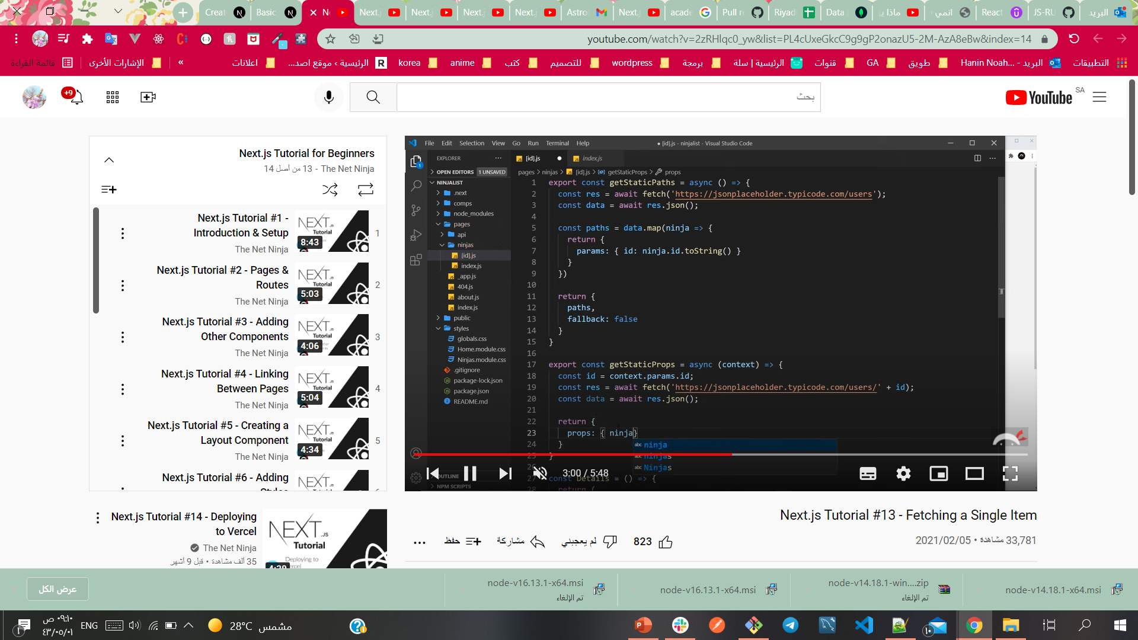
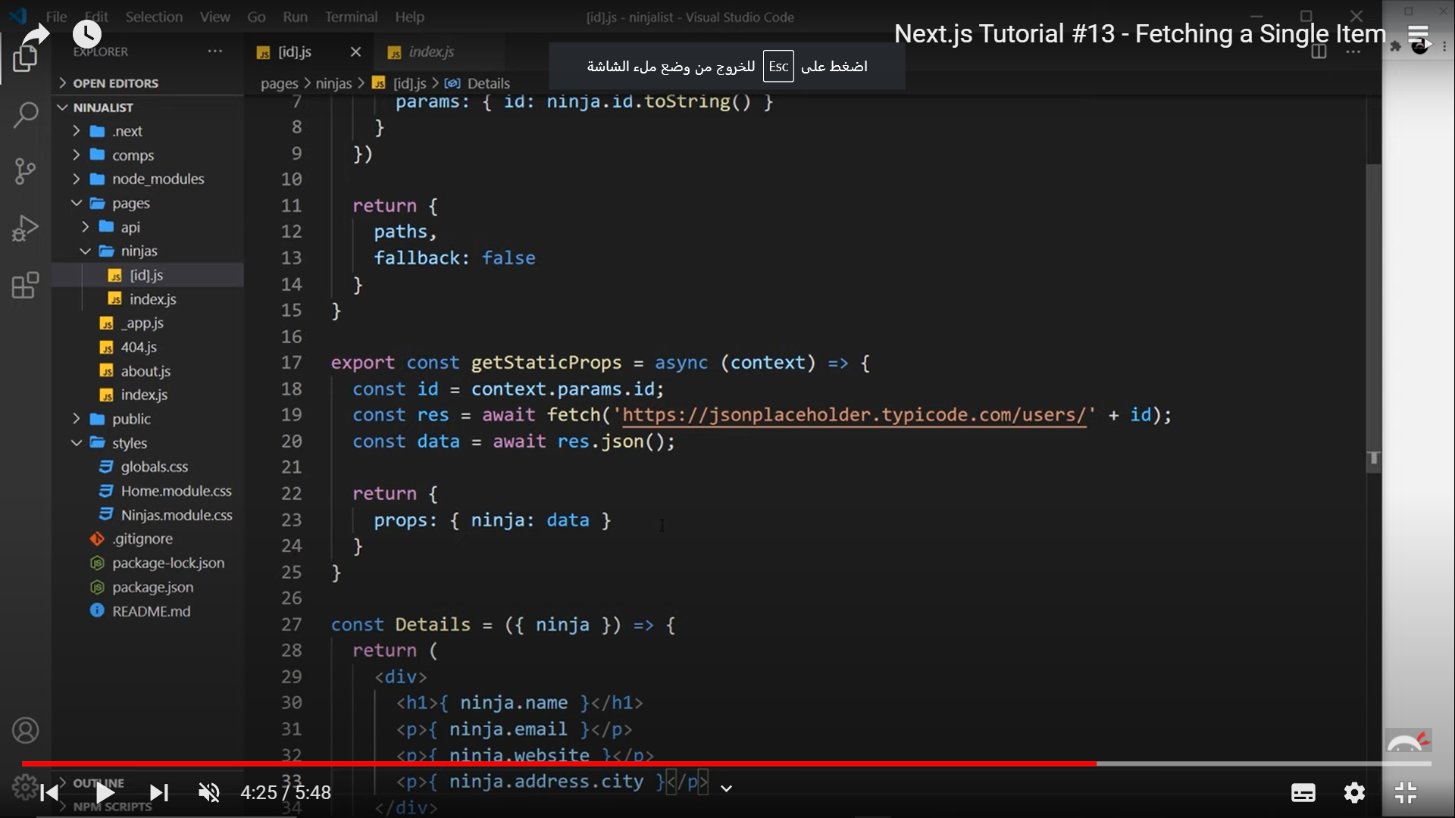
Fetching Data Dynamic Routes Fetching a Single Item(getStaticProps)
If a page has dynamic routes (documentation) and uses getStaticProps it needs to define a list of paths that have to be rendered to HTML at build time.
If you export an async function called getStaticPaths from a page that uses dynamic routes, Next.js will statically pre-render all the paths specified by getStaticPaths.

Slide 11



Resources
https://www.youtube.com/watch?v=A63UxsQsEbU&list=PL4cUxeGkcC9g9gP2onazU5-2M-AzA8eBw&index=1
https://www.youtube.com/watch?v=MFuwkrseXVE

